Slide 1
IPAPI
Find Your Taste Buds
By: James Lindsey, Walker Phillips, Jon Stivers, Alex Sabel

Slide 2
What is IPAPI?
IPAPI is a REST API that was designed for a user to find and discover new friends and beer.
The idea was brought to the forefront when we started talking about the interest that we had for beer. One thing we all agreed on is that sometimes, when you want to go get a drink, there isn’t a person to go share a beer with. This is when we thought of this great idea.
This was designed with every person in mind. This could be the average joe that is hanging out on the weekend or this could be for a beer sommelier that is doing research on popular beer ideas.
This is a idea that can be updated and worked on for many days after this project and can be used for many years to come, especially with the Nashville market growing the way it is.

Slide 3
What People Worked On
James - Worked on the Connections to the Heroku app and also worked on Models and Data input troubleshooting.
Walker - Worked on the framework and building of HTML Pages/Handlebars.
Alex - Worked on the designs through CSS and Handlebars for all pages.
Jon - Worked on the HTML Framework and design of Login screen and also the main page.
Matt - Helped with the design, troubleshooting, and build of the pages/database and presentation.

Slide 4
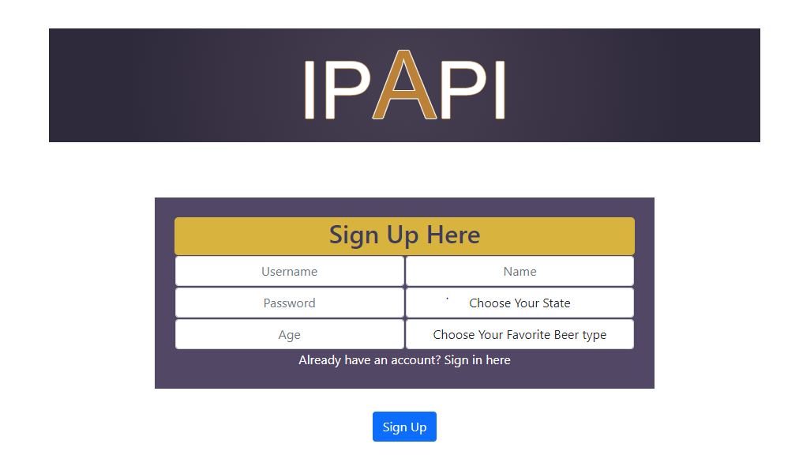
IPAPI

Slide 5
Questions & Comments

